Slide 1
Blogger Locale
By
Nandanamudi, Jyothi Kiran
Yaganti, Ashok
Pullela, Tejaswi
Kadari, Pratap Rao

Slide 2
Introduction
Blogger Locale is an online blog which provides a smart way of posting articles, promotions, questions and all types of software related enquiries.
Latest technological improvements, new ideas can be shared with the world.
Human right groups, NGOs needs a medium to interact with the people to create social awareness of a social cause to reach huge number of people online.
Google or Yahoo are great for finding general stuff on the web at large, but sometimes you want to find real posts from real people, and blogs are great for that.
But, the present blogs lag in understanding the searcher's intent and generating the more relevant results.

Slide 3
Motivation
The main motivation is from the present available blogs which lags in providing a better of search engine.
Our main objective is to limit the search results to compare with the requested post in a blog.
It should be compatible with all platforms and should be mobile friendly.
Identifying the topic to which the search tags are related to using LDA, Naive Bayes.
Usage of available API’s to make the blog interesting as well as place where the user can search using different engines.

Slide 4
Workflow
User Request
NLP
TFIDF
WordNet
Relation Extraction and NER
Feature Vector
LDA
SPARQL
Ontology
Naive Bayes
Search

Slide 5
Features
User account registration.
Mobile compatible.
Submission of post either by static or file upload or API.
Filtered Search.
Identifying the topic to which the user request relates to.
Identifying the triples in the available data.
Wikipedia Search Engine for information while writing a post.
Google Search Engine for information while writing a post.
Edit, delete or update a post by using a filter of posts.

Slide 6
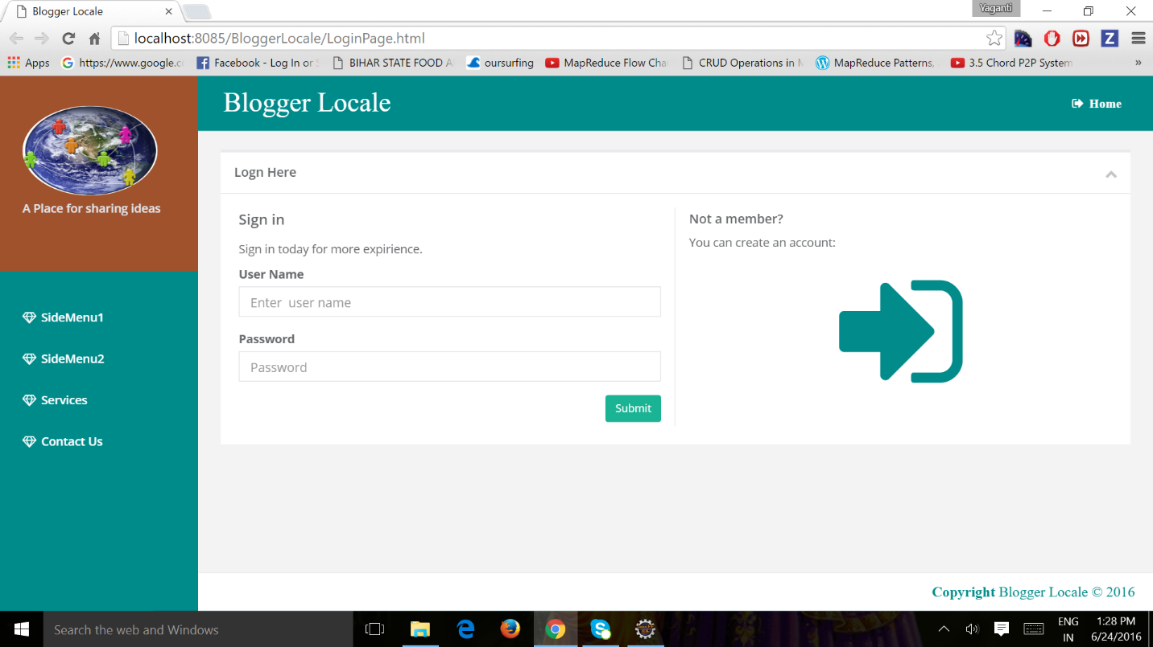
Screenshots
Login Page:

Slide 7
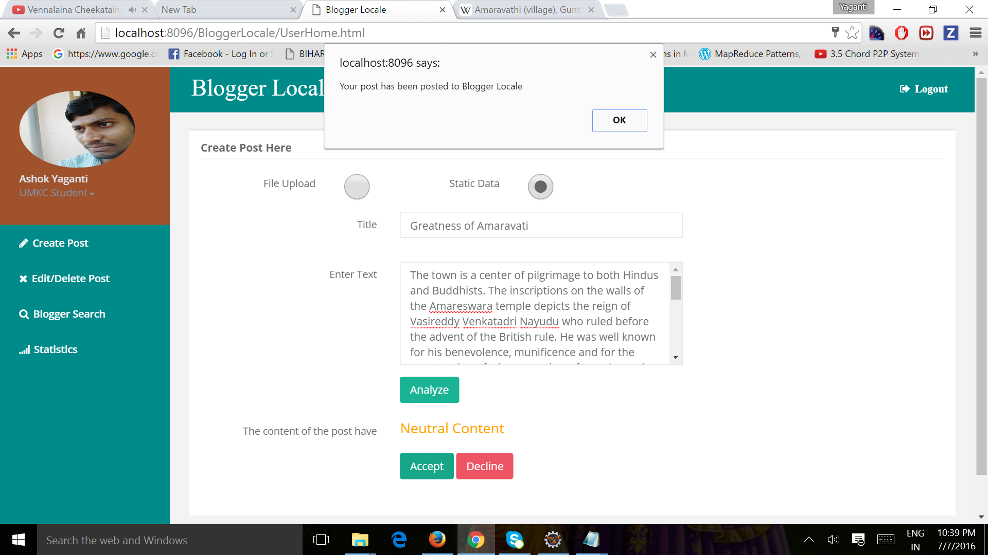
Post Submission

Slide 8
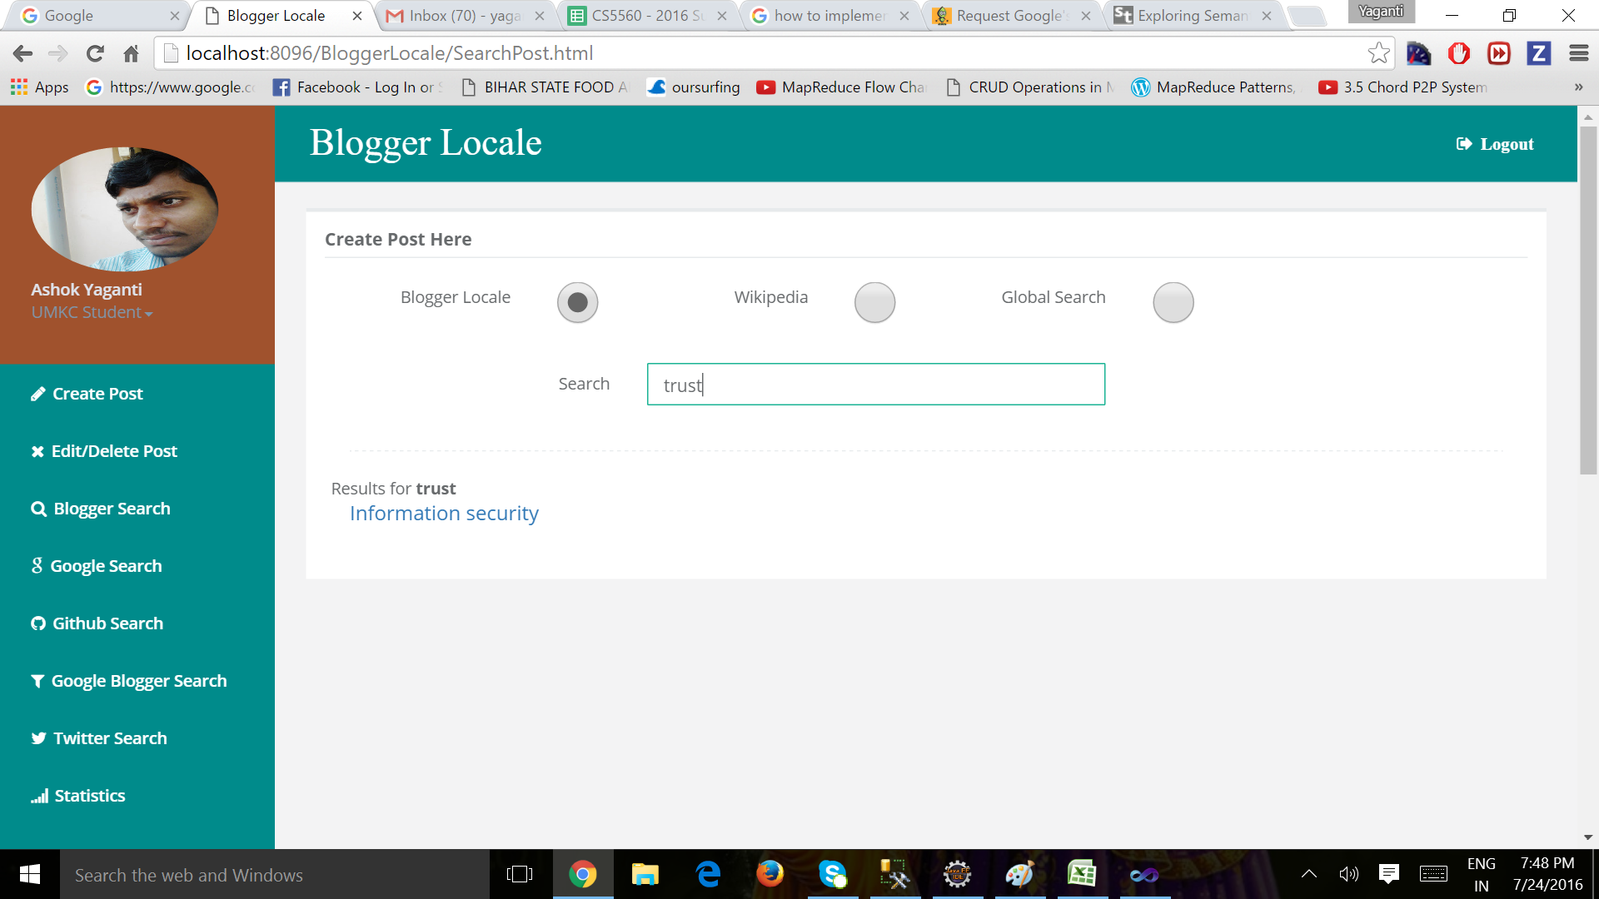
Semantic Search

Slide 9
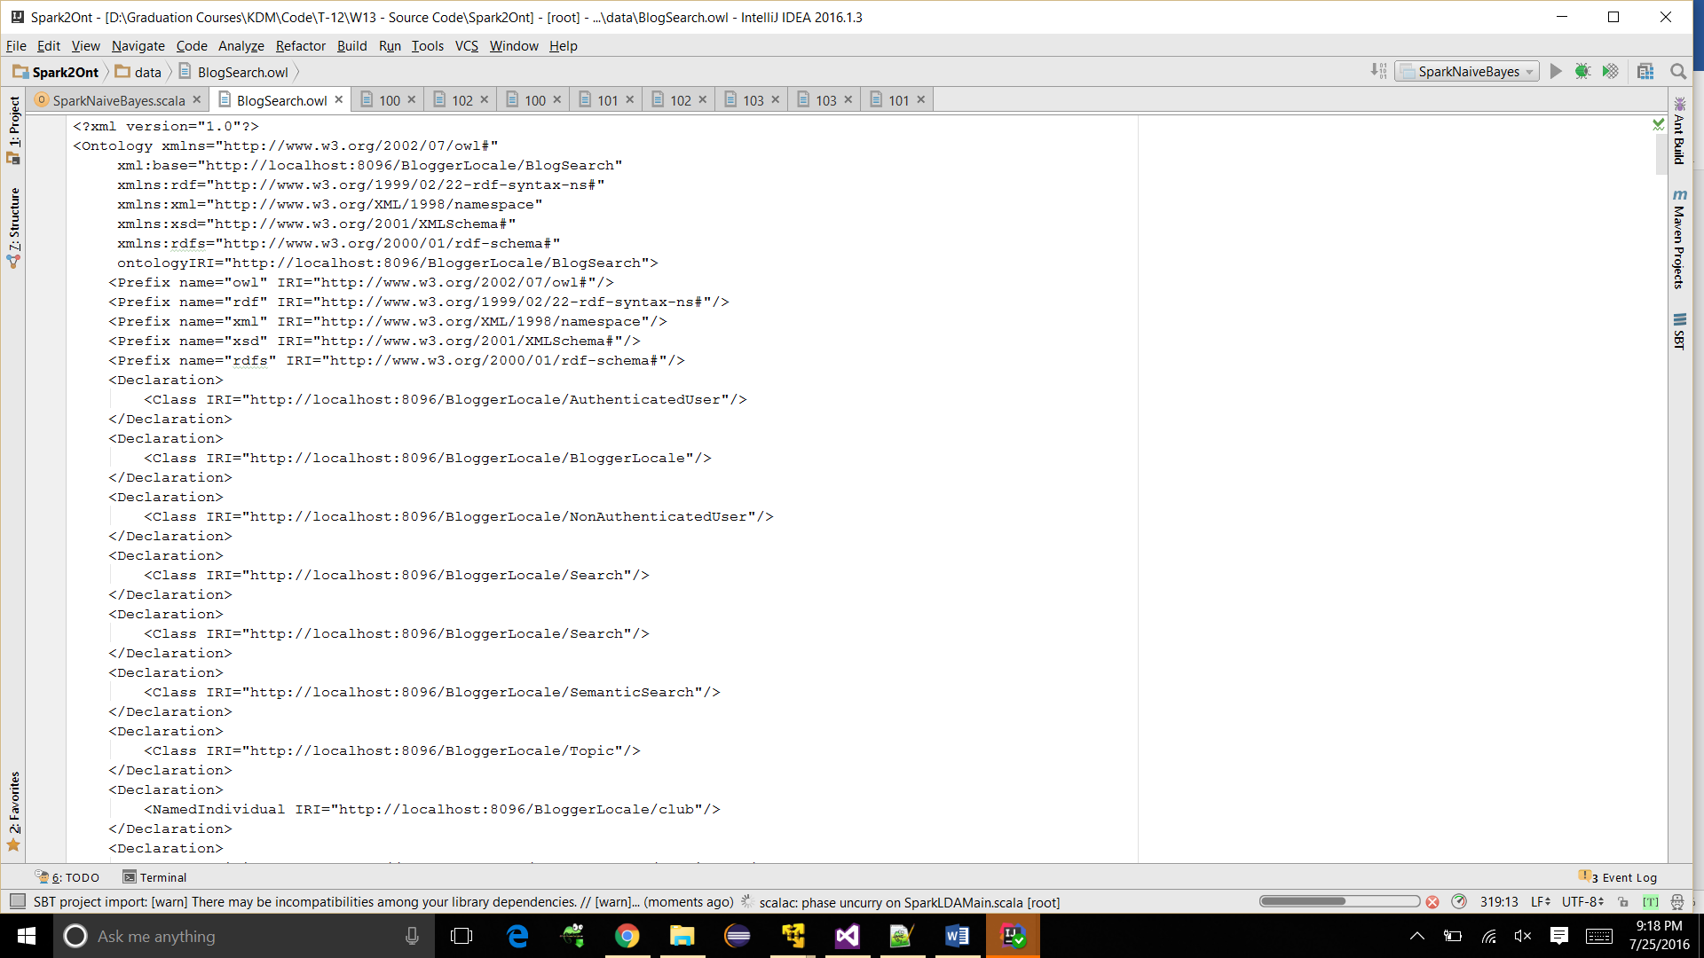
OWL file generation

Slide 10
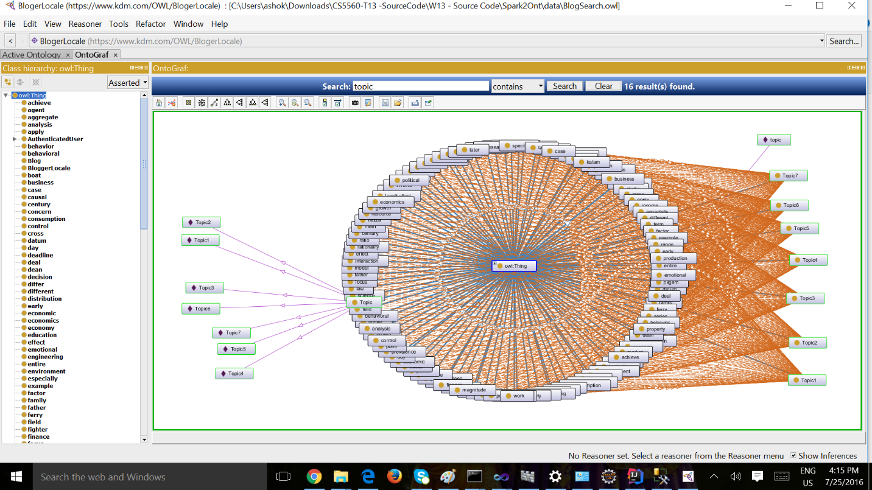
Ontology

Slide 11
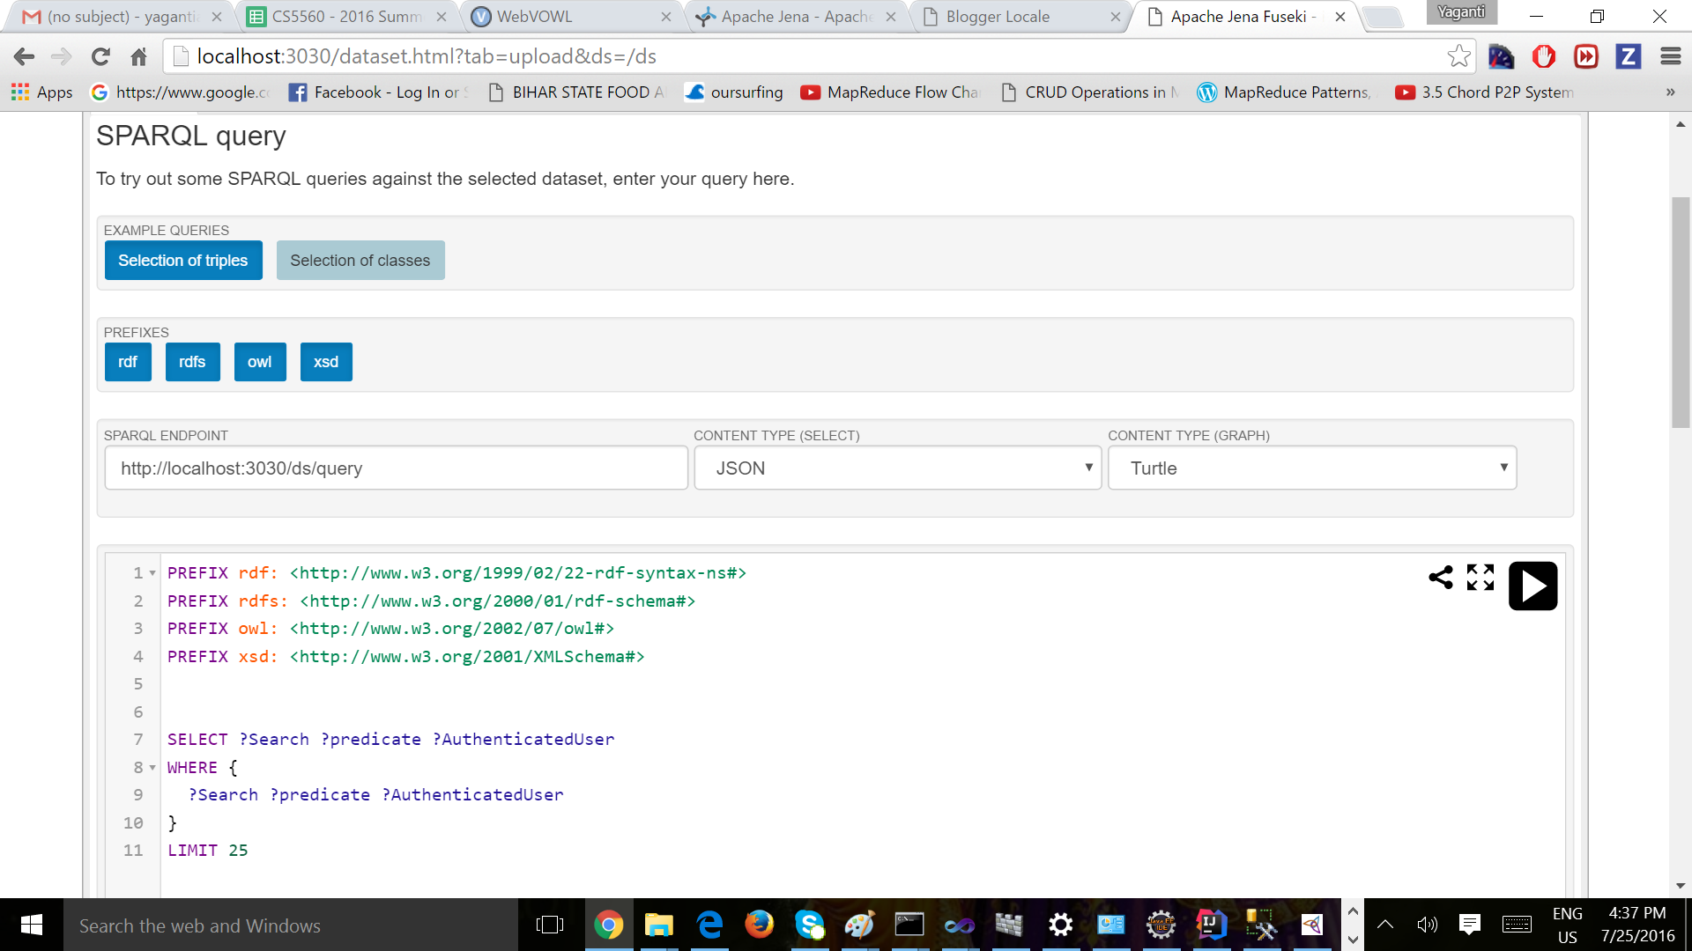
SPARQL query

Slide 12
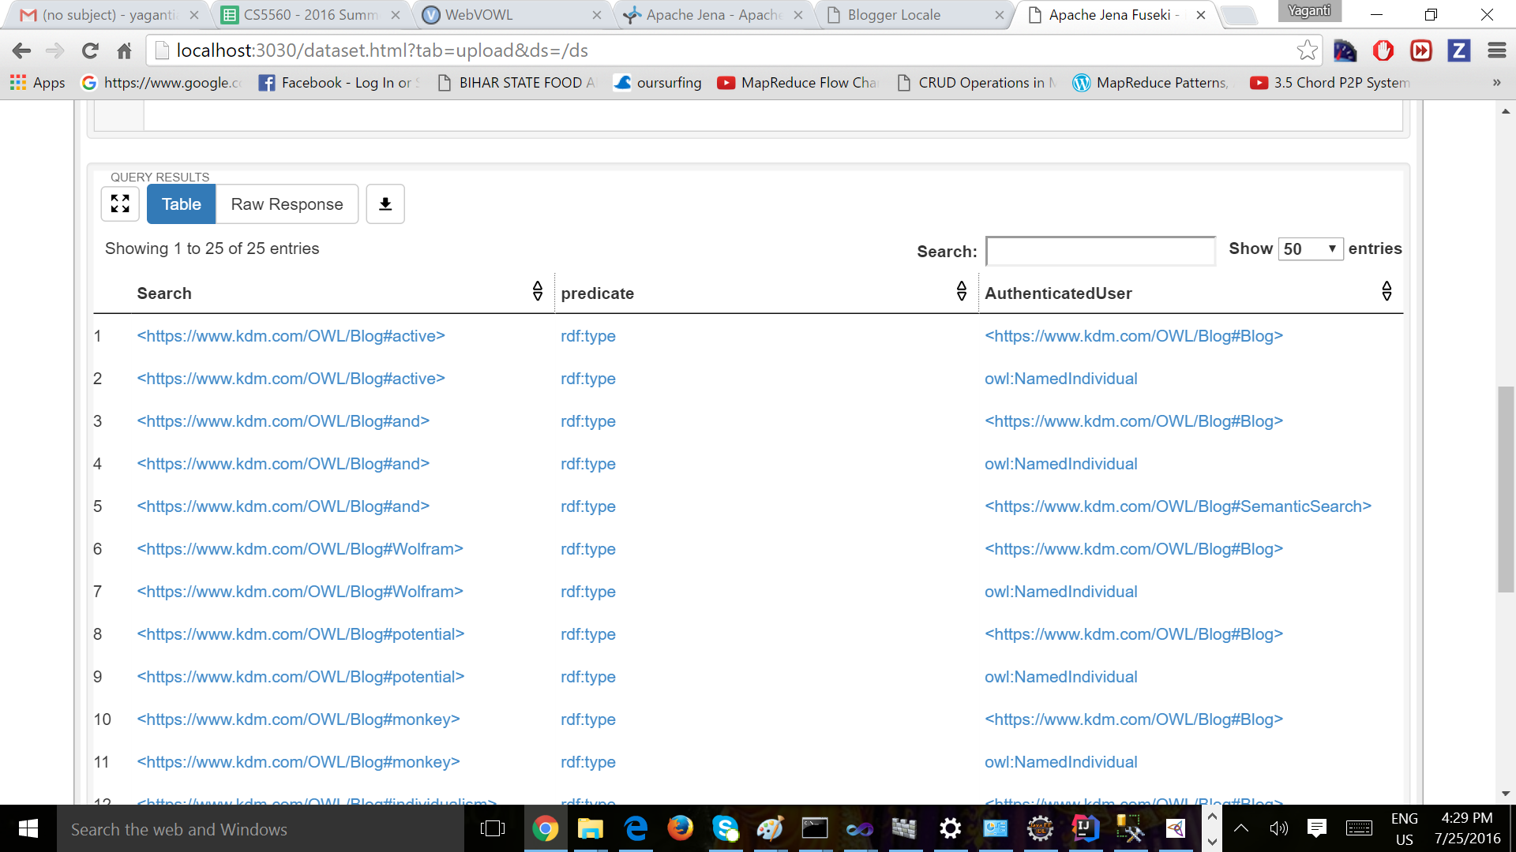
Results:

Slide 13
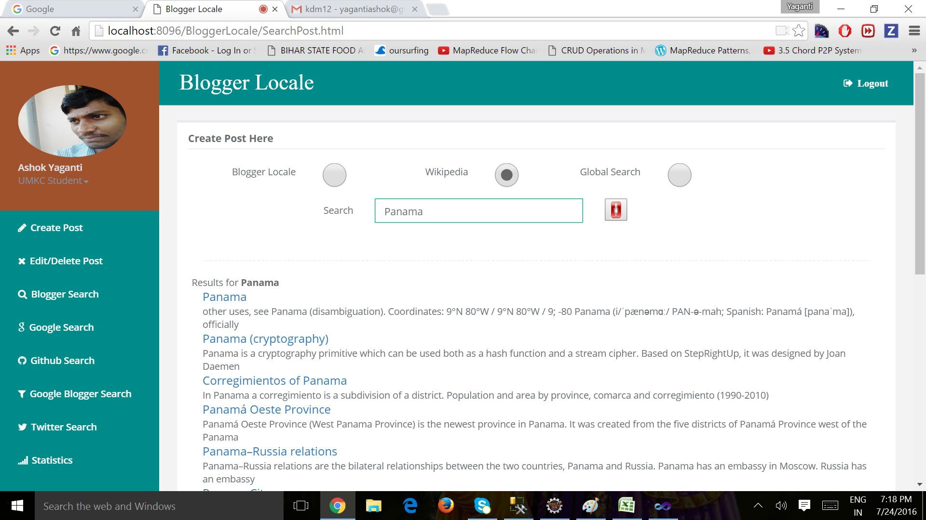
Wiki Search

Slide 14
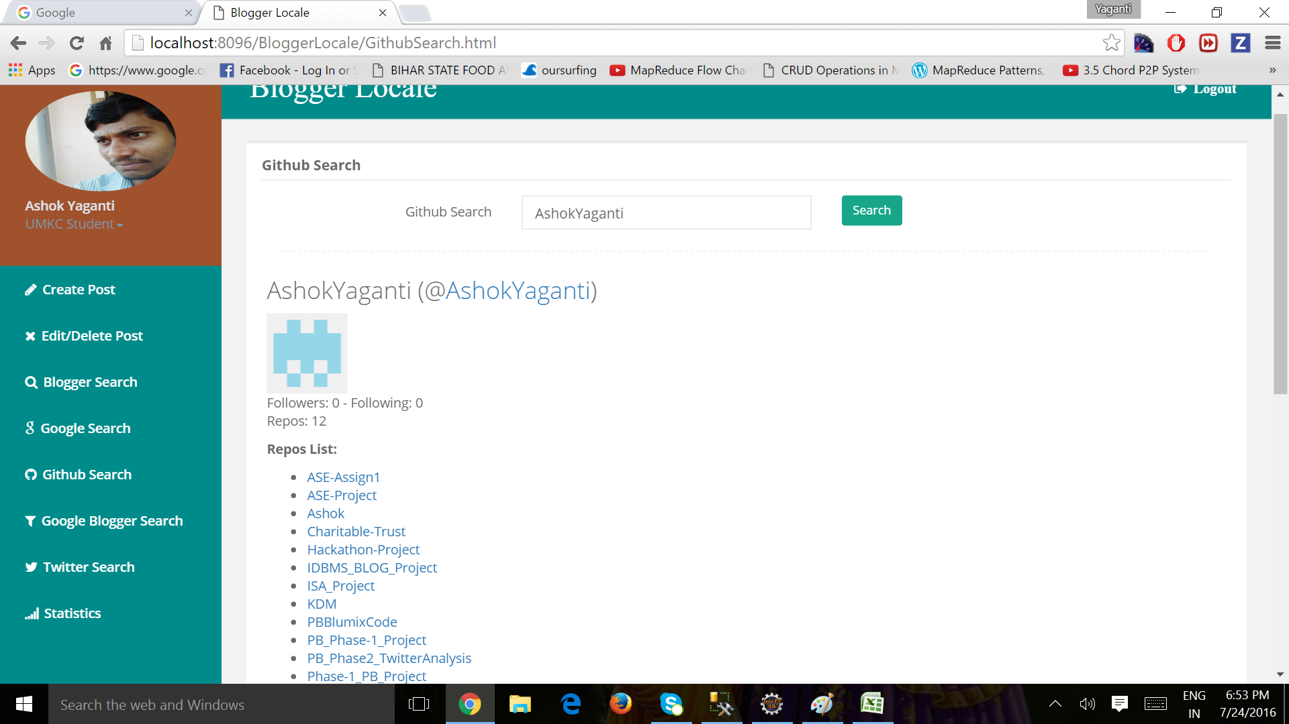
GitHub Repository Search

Slide 15
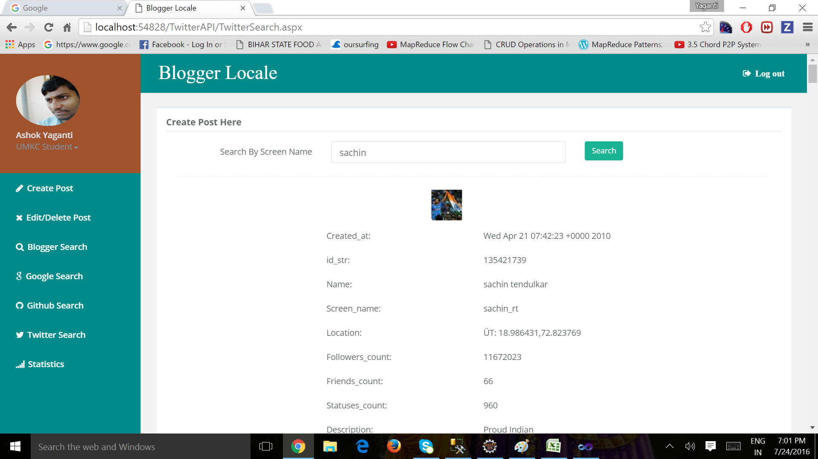
Twitter Search

Slide 16
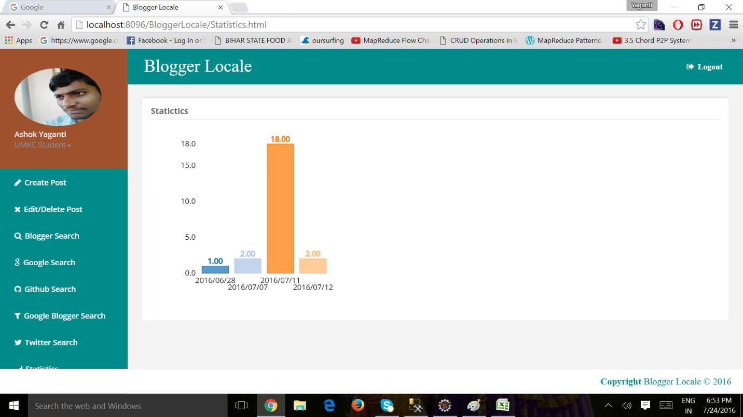
Statistics

Slide 17
DEMO

